Slide 1

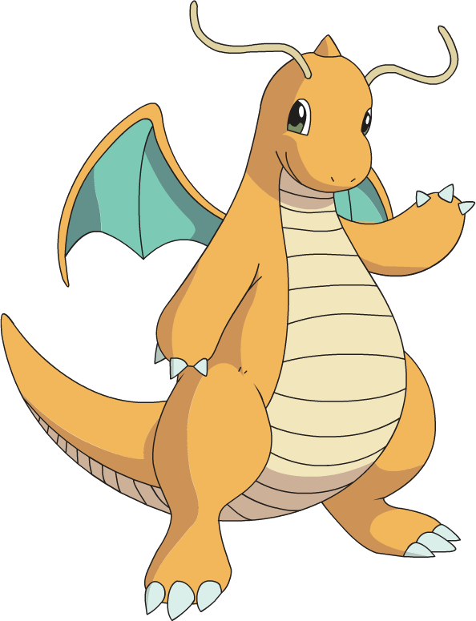
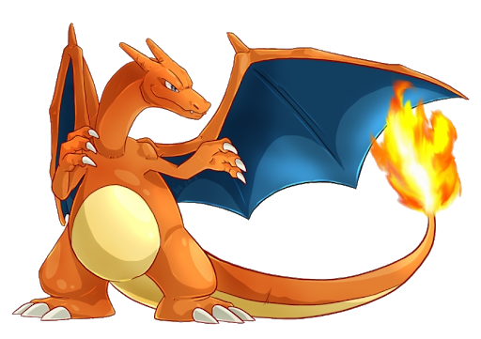
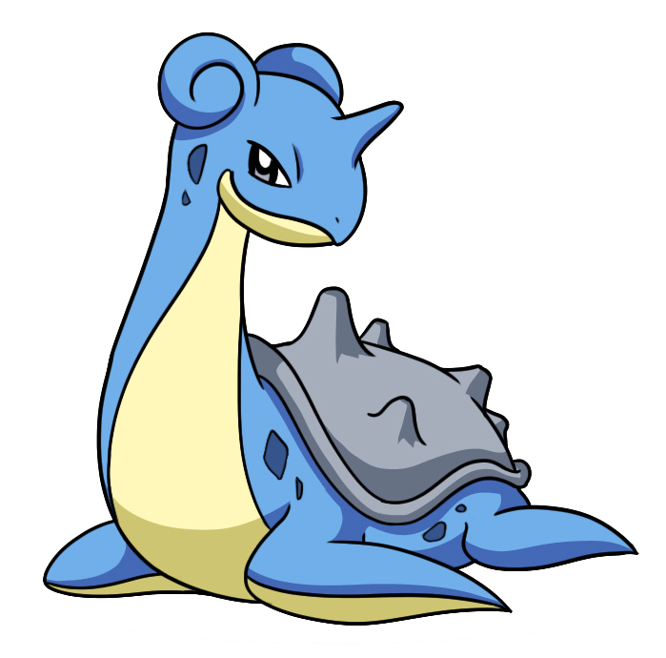
PokE World
Lukasz Ledzion 116753 Jakub Kozlowski 116707

Slide 2
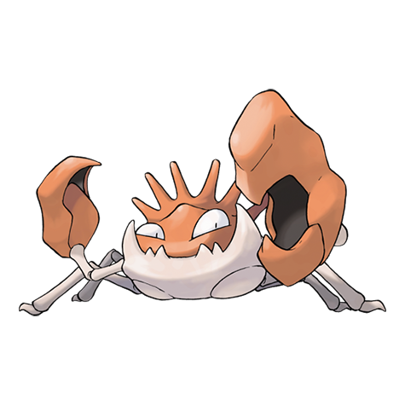
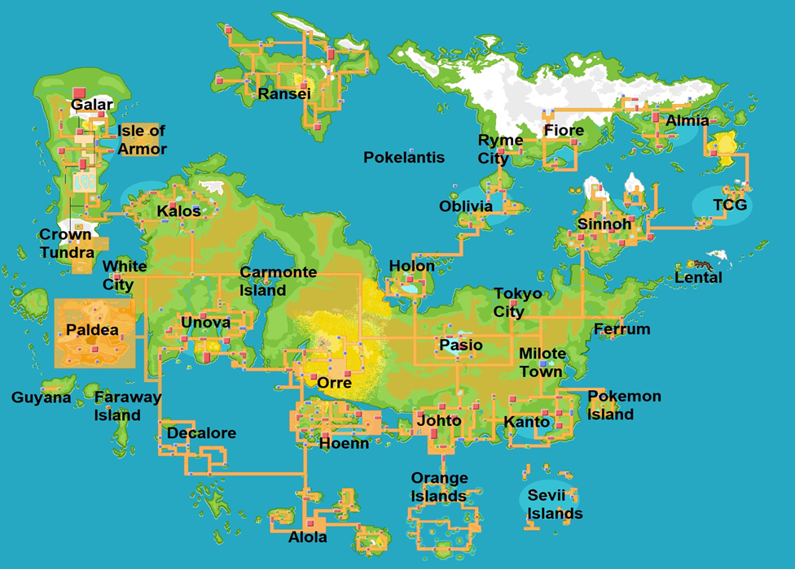
Why?
As part of our project, we decided to create a Pokemon project that can be used by all people who play games or watch videos of Pokemon content. On the Internet, we can find a lot of information about the list of pokemons, but there is little information about their world, that is: regions, cities, islands, Gyms, Gym Leaders and Trainers, or even badges for defeating Gym Leader.

Slide 3
Tables description
People - we have a lot of people. They can be trainers or leaders but they dont have to.
Players - We have a lot of players, they have own id, total number of collected badges, and number of win duels.
Leaders -player may be also a leader, every leader has id, name, and date when he become a leader
Player_hand- every player can has list of pokemons to fight with other player, it is a limited, to 6 pokemons.
Pokemons - in our database we have pokemons from few regions, every pokemon has id, name, evolution level and own type
Types - We had few types, around 15 like fire, water, grass, poison, rock, ground…
Regions From other side we have regions, which consist of id, name, populatons, area,
Cities - every region has own cities, Cities consist of id, city population, name.
Gyms - We have also gyms where players fights agains leaders.
Islands - each region can has also island, where could be also gyms.
Moves – Each pokamon has one move, moves have own power name.
Buildings – each city has own buildings, you find there, name, area, floors
Deleted_Poks_from_hand – this table is trigger, it is created when player will delete one of his pokemons from hand.

Slide 4
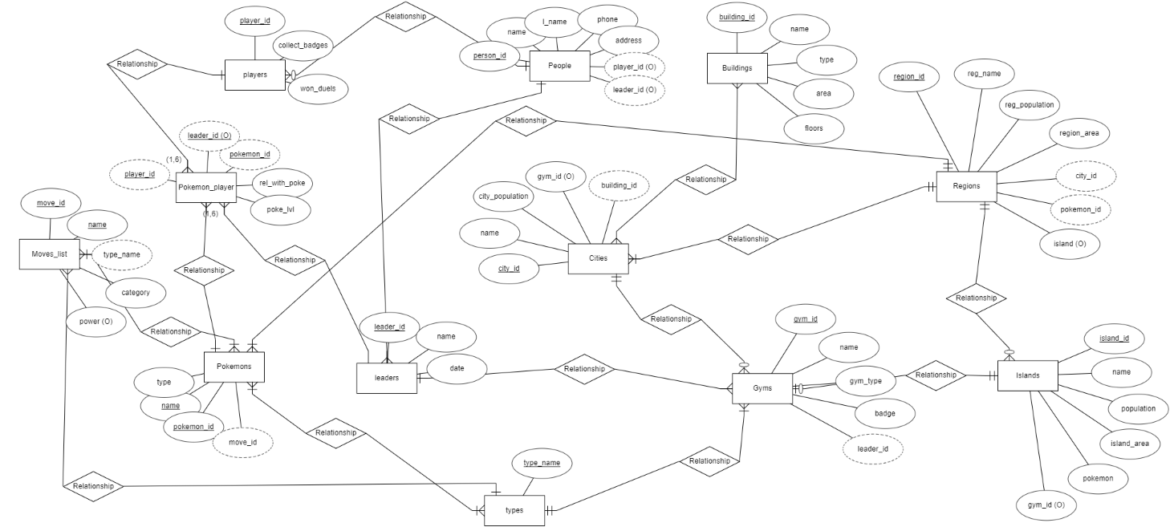
Origin of the pocket pets
Venus has a beautiful name
It’s the closest planet to the Sun
VENUS
MERCURY
01
02
03
04
SATURN
JUPITER
Saturn was named after a Roman god
It’s the biggest planet of them all

Slide 5
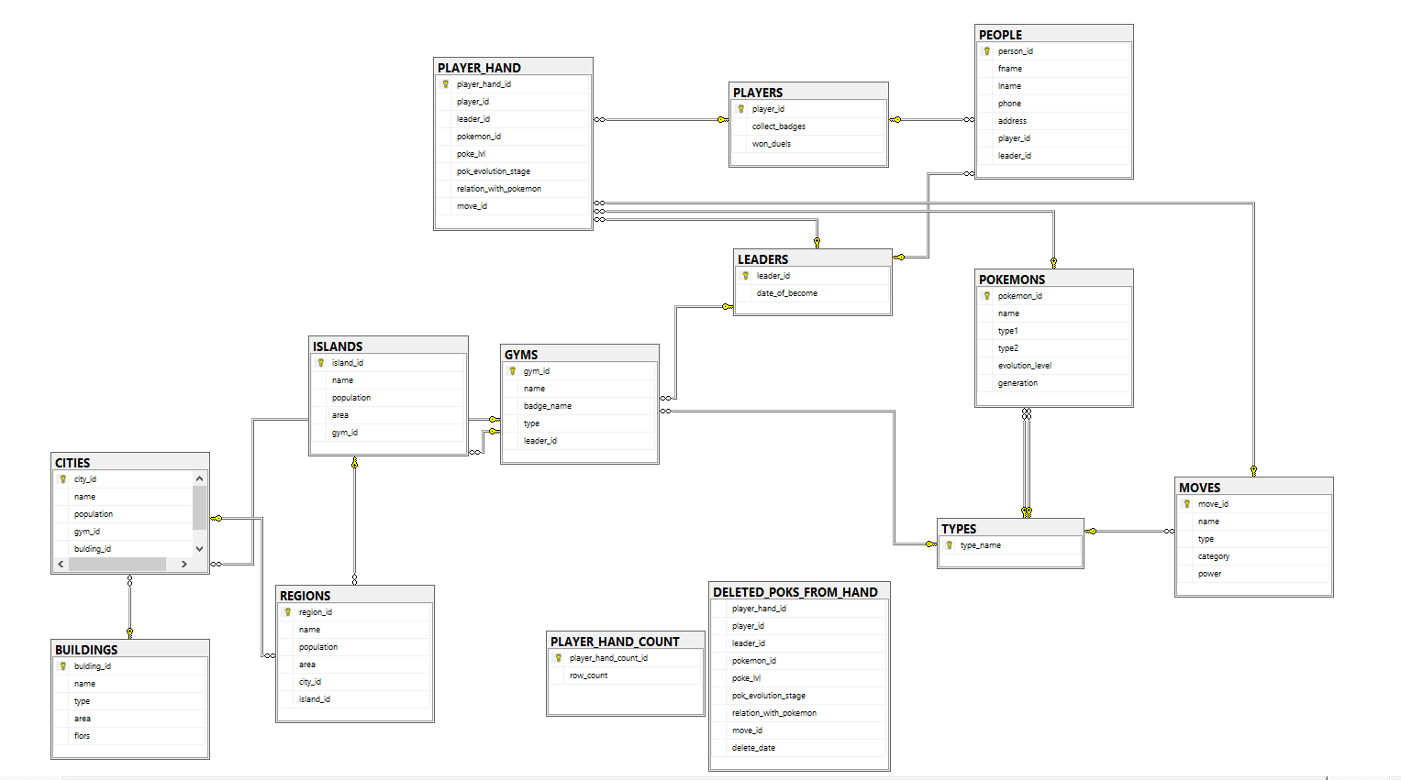
Pocket pet characteristics
MERCURY
VENUS
Mercury is the closest planet to the Sun and the smallest one in the Solar System—it’s only a bit larger than the Moon
Venus has a beautiful name and is the second planet from the Sun. It’s terribly hot and has a poisonous atmosphere

Slide 6
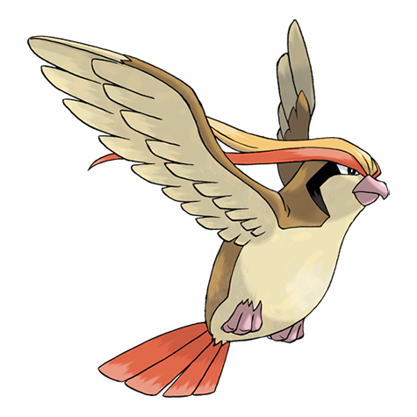
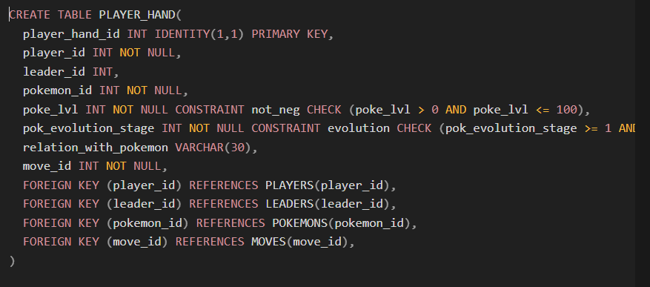
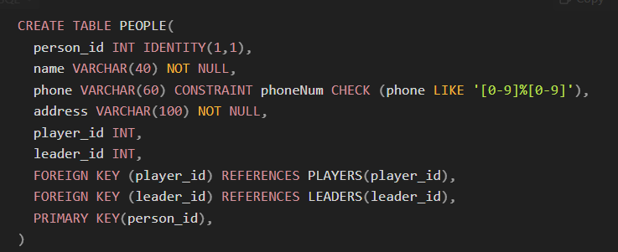
Create tables
Autoincrement key
Constraints
Foreign keys
Primary keys
Not null and optional

Slide 7
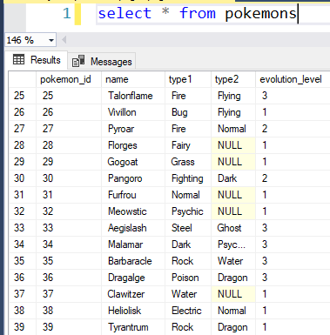
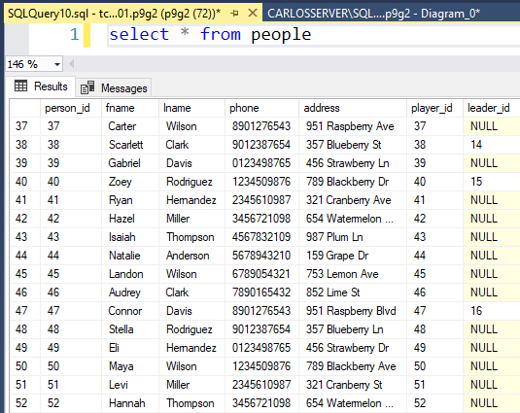
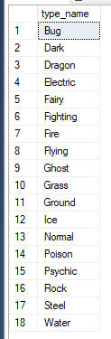
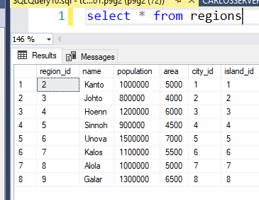
Inserted data

Slide 8
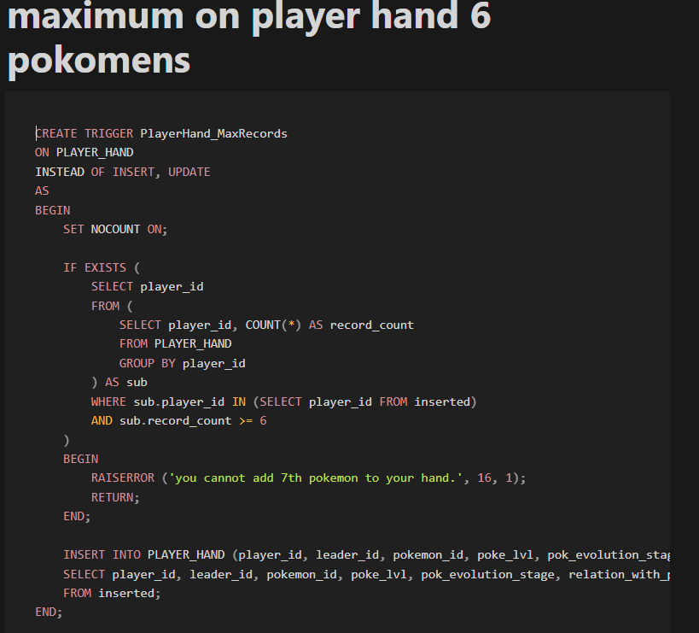
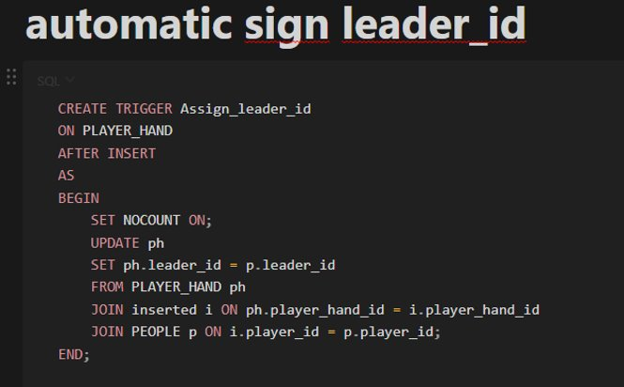
triggers
More triggers like: - insert table when player delete pokemon from hand
-prevent delete leader signed to gym
-prevent delete pokemons
-and many more like deletes, counts, etc...

Slide 9
SQL PROCEDURE AND UDF - 14
POKEMON – INSERT UPDATE DELETE
PEOPLE – INSERT UPDATE DELETE
GYMS – INSERT UPDATE DELETE PLAYERS – INSERT AND DELETE
G

Slide 10
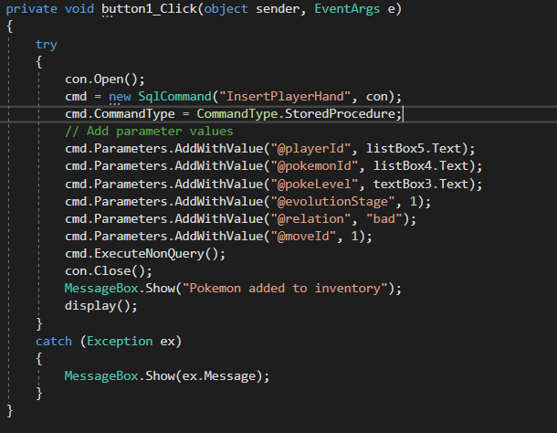
INSERT
CREATE PROCEDURE InsertPlayerHand
@playerId INT,
@pokemonId INT,
@pokeLevel INT,
@evolutionStage INT,
@relation VARCHAR(50),
@moveId INT
AS
BEGIN
INSERT INTO PLAYER_HAND (player_id, pokemon_id, poke_lvl, pok_evolution_stage, relation_with_pokemon, move_id)
VALUES (@playerId, @pokemonId, @pokeLevel, @evolutionStage, @relation, @moveId)
END

Slide 11
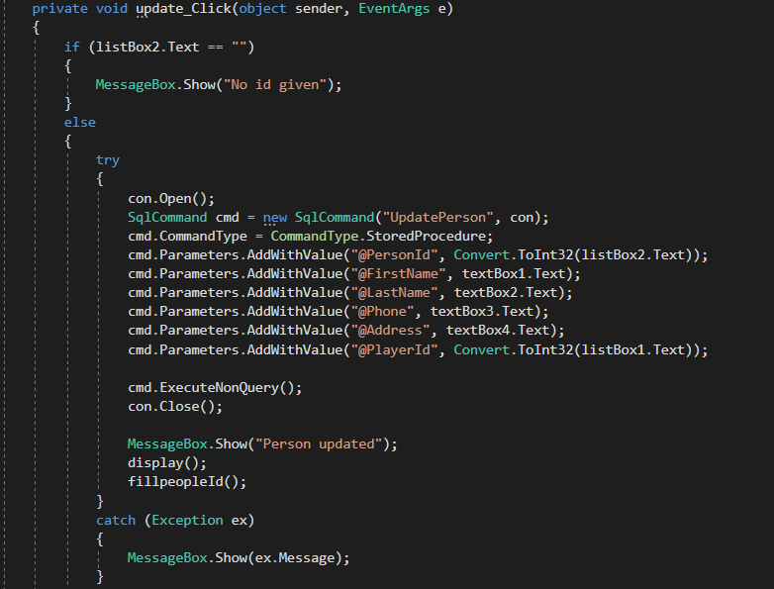
UPDATE
CREATE PROCEDURE UpdatePerson
@PersonId INT,
@FirstName VARCHAR(255),
@LastName VARCHAR(255),
@Phone VARCHAR(255),
@Address VARCHAR(255),
@PlayerId INT
AS
BEGIN
UPDATE people
SET fname = @FirstName,
lname = @LastName,
phone = @Phone,
address = @Address,
player_id = @PlayerId
WHERE person_id = @PersonId;
END;

Slide 12
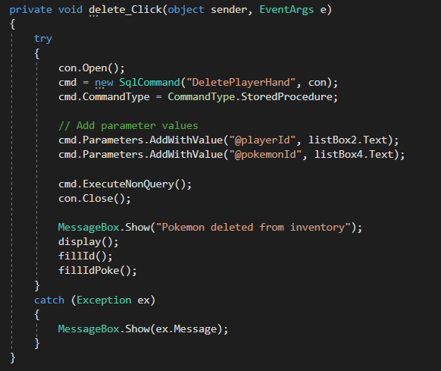
DELETE
CREATE PROCEDURE DeletePlayerHand
@playerId INT,
@pokemonId INT
AS
BEGIN
DELETE FROM PLAYER_HAND
WHERE player_id = @playerId AND pokemon_id = @pokemonId
END

Slide 13
VIEWS - 10
DISPLAY CITIES
DISPLAY ISLANDS
DISPLAY REGIONS
DISPLAY POKEMONS
DISPLAY PEOPLE – BASED ON PEOPLES LEADERS AND PLAYERS
DISPLAY PLAYER HAND – BASED ON PLAYERS AND PLAYER HAND
DISPLAY PLAYER - BASED ON PEOPLE AND PLAYERS
DISPLAY GYMS - BASED ON LEADERS CITIES PLAYERS AND PEOPLES

Slide 14
EXAMPLES
CREATE VIEW displayInventory AS
SELECT PLAYER_HAND.pokemon_id,PLAYER_HAND.pok_evolution_stage,PLAYER_HAND.relation_with_pokemon,PLAYER_HAND.poke_lvl FROM PLAYERS LEFT JOIN PLAYER_HAND ON PLAYER_HAND.player_id = PLAYERS.player_id LEFT JOIN PEOPLE ON people.player_id = players.player_id;
CREATE VIEW displayGym2 AS
SELECT gyms.gym_id,gyms.name,gyms.badge_name,gyms.type,fname +' '+ lname AS leader,leaders.leader_id, cities.name AS 'City name',BUILDINGS.name AS 'Name of building' FROM gyms LEFT JOIN leaders ON leaders.leader_id = gyms.leader_id LEFT JOIN PEOPLE on people.leader_id = leaders.leader_id LEFT JOIN CITIES ON cities.gym_id = gyms.gym_id LEFT JOIN BUILDINGS ON BUILDINGS.bulding_id = cities.bulding_id;
CREATE VIEW displayHand AS
SELECT PLAYER_HAND.pokemon_id,PLAYER_HAND.pok_evolution_stage,PLAYER_HAND.relation_with_pokemon,PLAYER_HAND.poke_lvl FROM PLAYERS LEFT JOIN PLAYER_HAND ON PLAYER_HAND.player_id = PLAYERS.player_id;

Slide 15
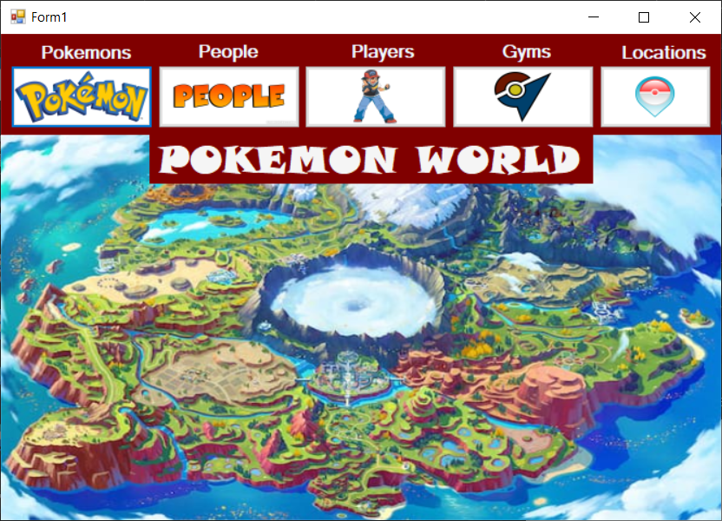
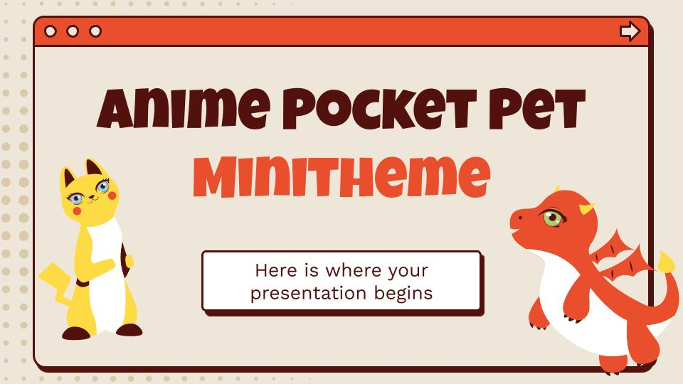
Interaction GRAPHIC FORM
POKEMONS
Add DELETE UPDATE SEARCH SORT
PEOPLE
Add DELETE UPDATE SEARCH SORT
PLAYERS
ADD DELETE TO INV, SEARCH PLAYER AND HIS INVENTORY
GYMS Add DELETE UPDATE SEARCH SORT
LOCATION SEARCH SORT

Slide 16
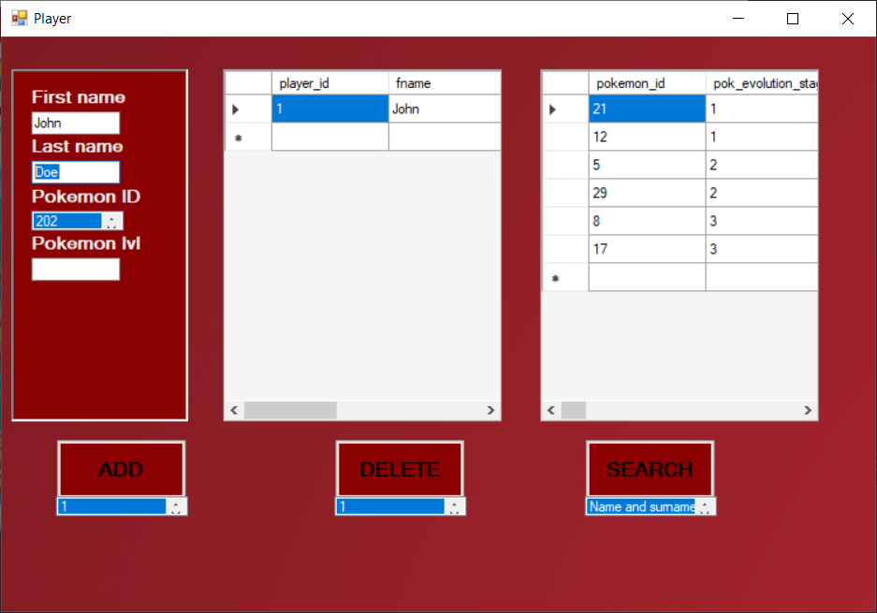
PLAYERS
Search FOR PLAYER Name AND SURNAME
SEARCH FOR INVENTORY
ADD TO INVENTORY
Delete FROM INVENTORY

Slide 17
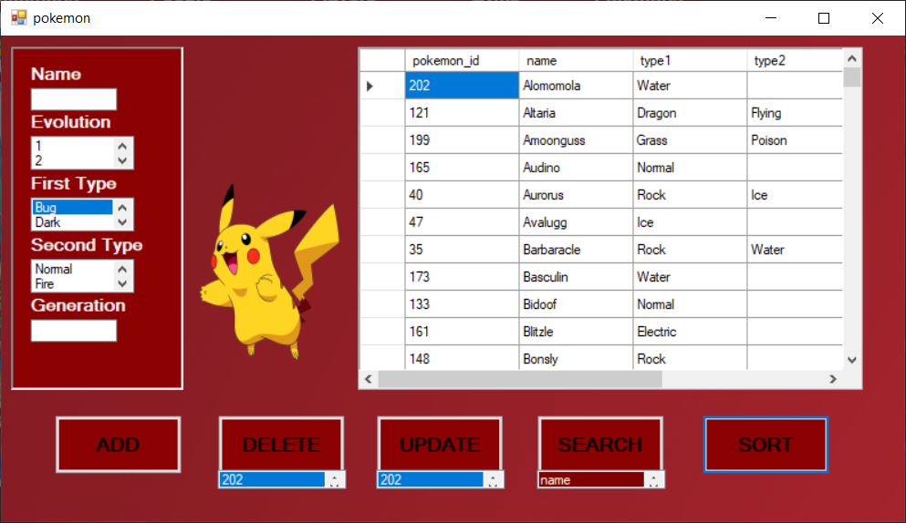
POKEMONS
Search Name Type EVOLUTION GENERATION
Add
Delete
Update
Sort

Slide 18
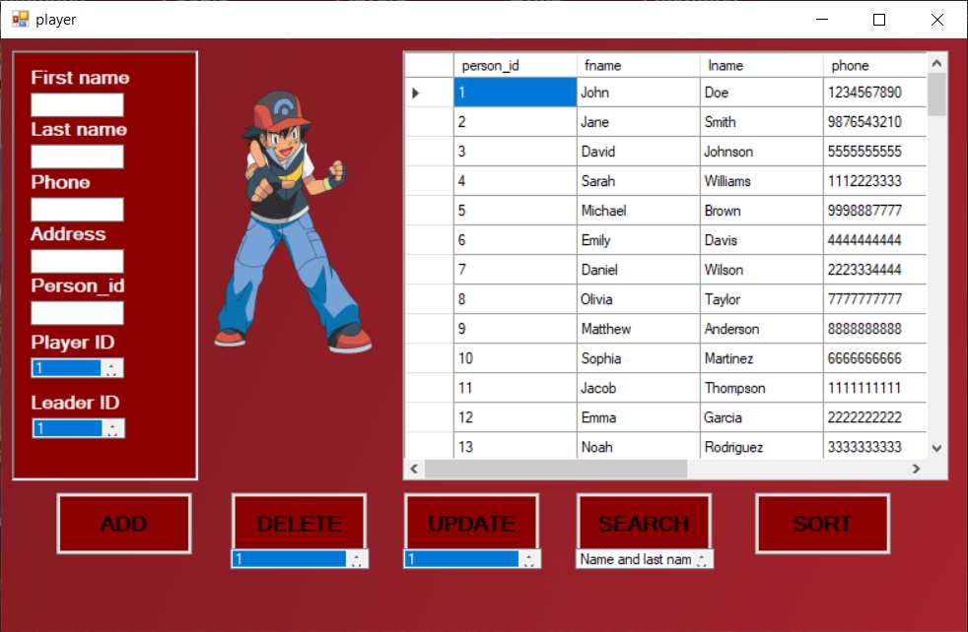
People
Search
Add
Delete
Update
Sort

Slide 19
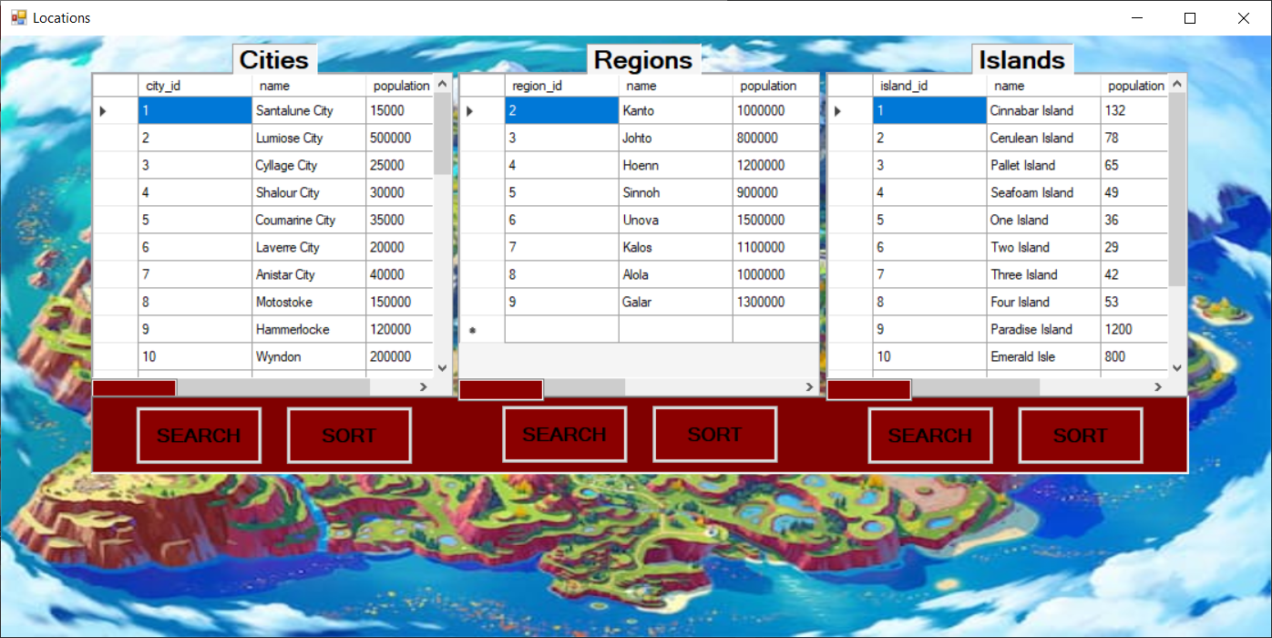
LOCATIONS

Slide 20
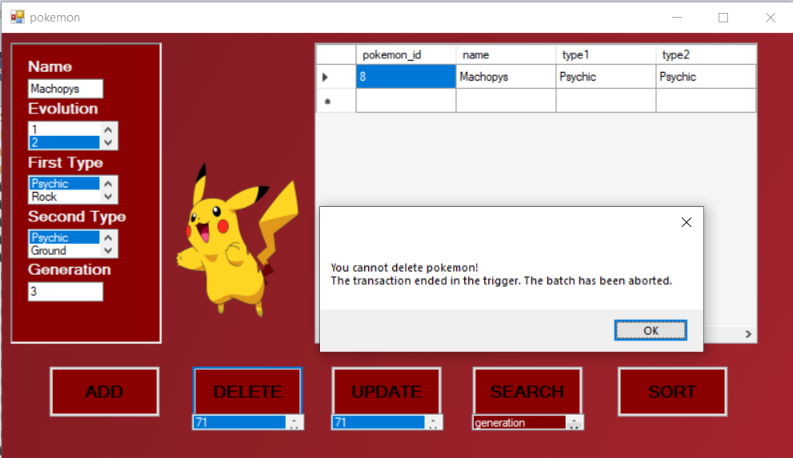
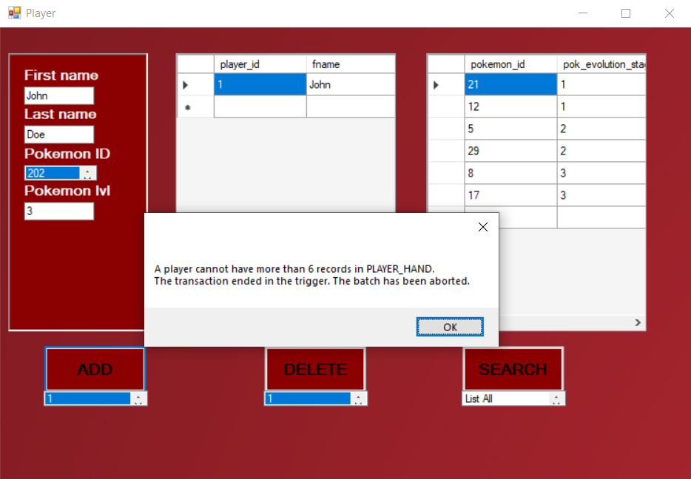
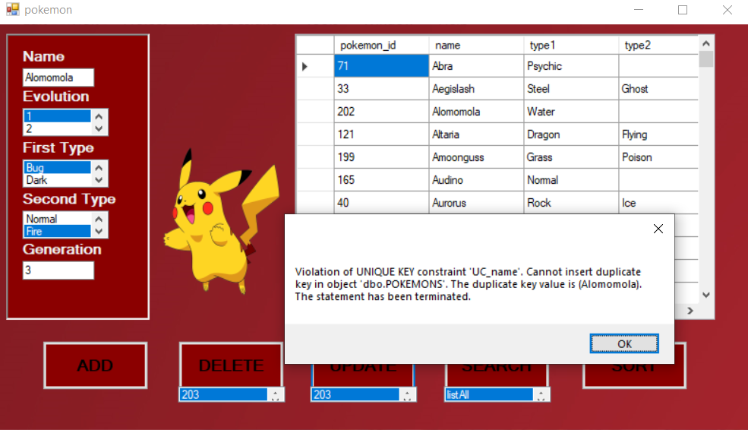
TRIGGERS

Slide 21
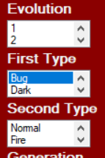
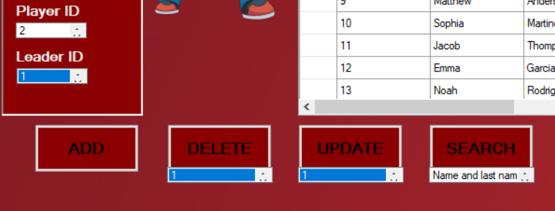
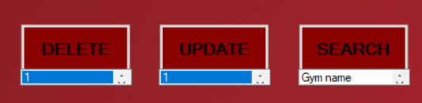
LISTS

Slide 22
DEMO TIME

Slide 23
THANKS

